Slide 1
Software Quality Assurance and Testing Technology
2nd Semester, Spring 2022
Haiming Liu
liuhaiming@bjtu.edu.cn
School of Software Engineering
Beijing Jiaotong University

Slide 2
16 Weeks Plan
Week 1: The basic concepts and theories of testing
Week 2-3: Principles of Testing
Week 4: Test Cases
Week 5-6: Black Box Testing
Week 7-9: White Box Testing
Week 10: Integration Testing and System Testing
Week 11: Usability Testing and Accessibility Testing
Week 12: Security Testing
Week 13: Mutation Testing
Week 14: Software Quality
Week 15: Review I
Week 16: Review II

Slide 3
VERIFICATION
The process of evaluating a system or component during the development process to determine whether it satisfies the specifications.
THE CRITICAL QUESTION IS:
- Did we build what we planned to build?
Typically involves reviews and meetings to evaluate:
documents
plans
code
requirements
specifications

Slide 4
VALIDATION
The process of evaluating a system or component during the development process to determine whether it satisfies the user's requirements
THE CRITICAL QUESTION IS
“Did we build what the user wanted?”

Slide 5


Verification vs. Validation
Verification confirms that the software meets its specification.
- Are we building the product right？
Validation confirms that the software meets the user’s requirements.
- Are we building the right product ?
Never assume the specifications are correct when testing, Both V&V tests must be performed.
Example: The Hubble Space mirror was ground incorrectly (because the specs were wrong) and, consequently, it failed to produce clear pictures when originally launched.

Slide 6

Principle of Testing
Software process models are an ideal … not reality
No software development effort follows a process model perfectly. Why?
The specification never corresponds to the customers needs perfectly.
There is never enough time to perform all of the testing.
Nevertheless, an ideal model is helpful to make progress.
Trade offs and concessions are inevitable.

Slide 7
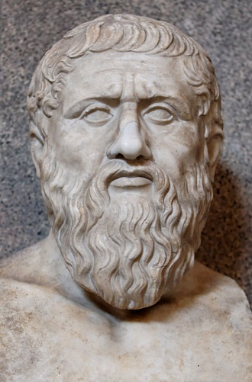
Principle of Testing
Plato had some interesting things to say about the ideal
Physical objects and physical events are shadows of their ideal or perfect forms
They exist only to the extent that they instantiate the perfect versions of themselves.
However, real physical objects are fleeting phenomena, the ideals of which they are mere instances.
Plato believed in perfect justice, perfect chairs, etc.
He would have also believed that the Waterfall model (or some variant of it) was a perfect process model :-)
427 – 347 B.C.

Slide 8
Principle of Testing
Software testing axioms
It is impossible to test a program completely.
Software testing is a risk-based exercise.
Testing cannot show the absence of bugs.
The more bugs you find, the more bugs there are.
Not all bugs found will be fixed.
It is difficult to say when a bug is indeed a bug.
Specifications are never final.
Software testers are not the most popular members of a project.
Software testing is a disciplined and technical profession.

Slide 9
Principle of Testing
Parenthesis: What is an axiom anyway?
An axiom is a sentence or proposition that is not proved or demonstrated and is considered as obvious or as an initial necessary consensus for a theory building or acceptation.
Therefore, it is taken for granted as true, and serves as a starting point for deducing and inferring other (theory dependent) truths.

Slide 10
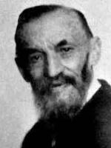
Principle of Testing
Peano’s axioms for the structure of natural numbers
1 is a natural number.
Every natural number is equal to itself (equality is reflexive).
For all natural numbers a and b, a = b if and only if b = a (equality is symmetric).
For all natural numbers a, b, and c, if a = b and b = c then a = c (equality is transitive).
If a = b and b is a natural number then a is a natural number.
If a is a natural number then successor(a) is a natural number.
If a and b are natural numbers then a = b if and only if successor(a) = successor(b).
If a is a natural number then successor(a) is not equal to 1.
For every set K, if 1 is in K, and successor(x) is in K for every natural number x in K, then every natural number is in K.

Slide 11
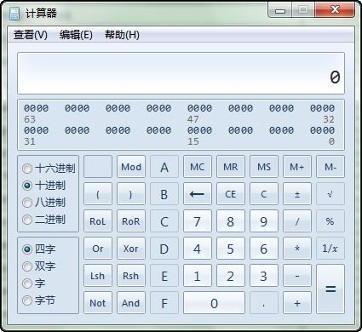
Principle of Testing
Axiom 1 It is impossible to test a program completely
How many test cases do you need to exhaustively test:
Powerpoint
A calculator
MS Word
Any interesting software!
The only way to be absolutely sure software works is to run it against all possible inputs and observe all of its outputs …
Oh, and the specification must be correct and complete.

Slide 12
Example
1+0=
1
1+1=
2
…
1+9999999999999999999999999=
2+0=
2
2+1=
3
…
2+9999999999999999999999999=

Slide 13
Example
1+0.1=
1.1
1+0.2=
1.2
…
1+0.9999999999999999999999999=
2+0.1=
2.1
2+0.2=
2.2
…
2+9999999999999999999999999=

Slide 14
Principle of Testing
Axiom 1 (cont’d) It is impossible to test a program completely
The number of possible inputs is very large.
The number of possible outputs is very large.
The number of paths through the software is very large.
The software specification open to interpretation.

Slide 15
Principle of Testing
Axiom 2 Software testing is a risk-based exercise
If you do not test the software for all inputs (a wise choice) you take a risk.
Hopefully you will skip a lot of inputs that work correctly.
What if you skip inputs that cause a fault?
Risk: financial loss, security, loss of money, loss of life!
That is a lot of pressure for a tester!
This course is all about techniques and practices to help reduce the.

Slide 16
Principle of Testing
Axiom 2 (cont’d) Software testing is a risk-based exercise
If you try to test too much, the development cost becomes prohibitive.
If you test too little, the probability of software failure increases and as we discussed … software failures can cost us big time!
Number of
Missed Bugs
Cost of
Testing
number
Under
Testing
Testing
Equilibrium
Over
Testing
Amount of Testing

Slide 17

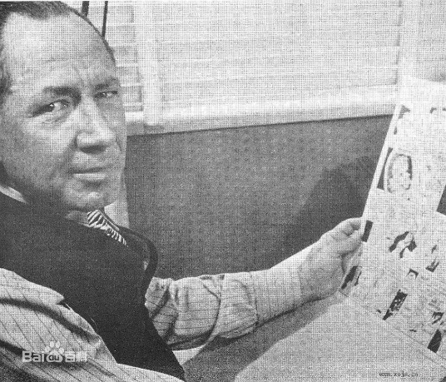
Principle of Testing
Axiom 2 (cont’d) Software testing is a risk-based exercise What about Murphy’s Law?
"If there's more than one possible outcome of a job or task, and one of those outcomes will result in disaster or an undesirable consequence, then somebody will do it that way.”
The law's name stems from an attempt to use new measurement devices developed by one Edward Murphy.

Slide 18
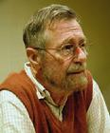
Principle of Testing
Axiom 3 Testing cannot show the absence of bugs
“Program testing can be used to show the presence of bugs, but never to show their absence!” - Edsger Wybe Dijkstra
Dijkstra received the 1972 ACM Turing Award for fundamental contributions in the area of programming languages

Slide 19

Principle of Testing
Axiom 4 The more bugs you find, the more bugs there are
Bugs appear in groups, where you see one you will likely find more … Why?
Programmers can have bad days
Programmers tend to make the same mistakes
Some bugs are just the tip of the iceberg.
Boris Beizer coined the term pesticide paradox to describe the phenomenon that the more you test software the more immune it becomes to your test cases.
Remedy: continually write new and different tests to exercise different parts of the software.

Slide 20
Principle of Testing
Axiom 5 Not all bugs found will be fixed
Why wouldn’t you fix a bug you knew about?
There’s not enough time
Some deadlines cannot be extended
It’s not really a bug
Specifications can be wrong
It’s too risky to fix
“I’m not touching Murphy’s code!”
It’s just not worth it
Bugs in fringe features may have to wait
Why not charge the customer for bug fixes in the next release (sound familiar?) :-)

Slide 21
Principle of Testing
Axiom 6 It is difficult to say when a bug is indeed a bug
If there is a problem in the software but no one ever discovers it … is it a bug?
What is your opinion? Does a bug have to be observable in order for it to be a bug?
Bugs that are undiscovered are called latent bugs.

Slide 22
Introduction
A software bug occurs when at least one of these rules is true
The software does not do something that specification says it should do.
The software does something that specification says it should not do.
The software does something that the specification does not mention.
The software does not do something that the specification does not mention but should.
The software is difficult to understand, hard to use, slow, or in the software tester's eyes will be viewed by the end user as just plain not right.
"If a tree falls in a forest and no one is around to hear it, does it make a sound?"

Slide 23

Principle of Testing
Axiom 7 Specifications are never final
Building a product based on a “moving target” specification is fairly unique to software development.
Competition is fierce
Very rapid release cycles
Software is “easy” to change
Not true in other engineering domains
E.g., the Brooklyn Bridge could not be adjusted to allow train traffic to cross it once its construction started.

Slide 24
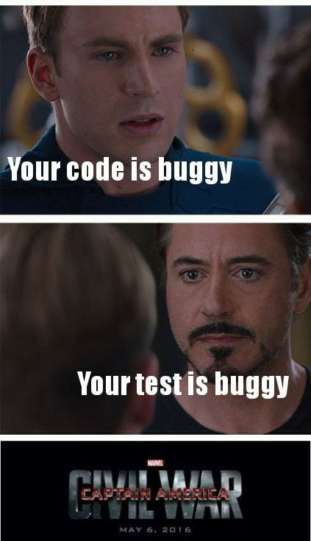
Principle of Testing
Axiom 8 Software testers are not the most popular members of a project
Goal of a software tester:
Find bugs
Find bugs early
Make sure bugs get fixed
Tips to avoid becoming unpopular:
Find bugs early
Temper your enthusiasm … act in a professional manner
Don’t report just the bad news

Slide 25
Principle of Testing
Axiom 9 Software testing is a disciplined and technical profession
When software was simpler and more manageable software testers were often untrained and testing was not done methodically.
It is now too costly to build buggy software.
As a result testing has matured as a discipline.
Sophisticated techniques
Tool support
Rewarding careers

Slide 26
Principle of Testing
You now know …
… the 9 axioms of software testing
… what is software verification
… what is software validation

Slide 27
To be continued… See you next week

